Slide 1
How can you help Sushma sharma (65+yr old)to life a healthier and better life?
Here I used if else condition for the identify the women suffering which type of dieses .
Library used web browser and play sound for vise msg
Idea from as Arogya setu app there also some question answering
So that’s why I used here numbering which define some dieses
as Arogya setu there also add such type of feature then it should be help for medicine and there doses for normal person who suffering such type of dieses
.

Slide 2
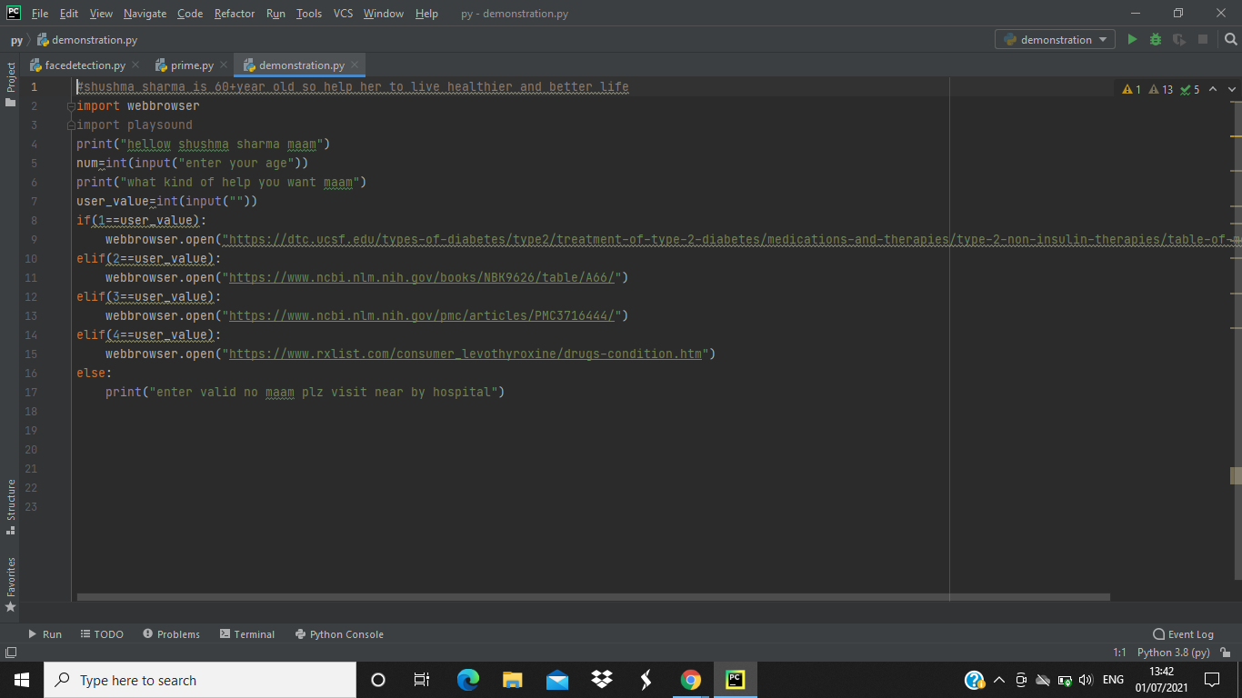
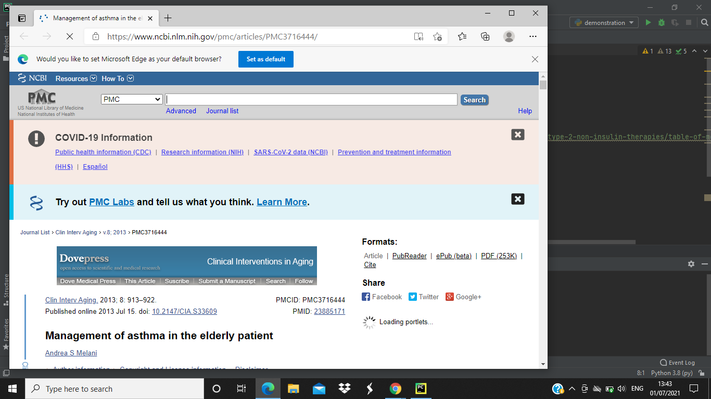
Code and its output

Slide 3
import webbrowser import playsound print("hellow shushma sharma maam") num=int(input("enter your age")) print("what kind of help you want maam") user_value=int(input("")) if(1==user_value): webbrowser.open("https://dtc.ucsf.edu/types-of-diabetes/type2/treatment-of-type-2-diabetes/medications-and-therapies/type-2-non-insulin-therapies/table-of-medications/") playsound.playsound("D;\pyaudio,mp3") elif(2==user_value): webbrowser.open("https://www.ncbi.nlm.nih.gov/books/NBK9626/table/A66/") playsound.playsound("D;\pyaudio,mp3") elif(3==user_value): webbrowser.open("https://www.ncbi.nlm.nih.gov/pmc/articles/PMC3716444/") playsound.playsound("D;\pyaudio,mp3") elif(4==user_value): webbrowser.open("https://www.rxlist.com/consumer_levothyroxine/drugs-condition.htm") playsound.playsound("D;\pyaudio,mp3") else: print("enter valid no maam plz visit near by hospital")

